Slide 1
C/C++ Program Design
Lab 1, environment configuration
廖琪梅, 王大兴

Slide 2
Environment Configuration
Download and install GCC on Windows 10 (Based on Windows Subsystem for Linux)
Download and install LLVM on macOS
Download and install the editor (VSCode)
Compile, link and run C/C++ programs
Set output format

Slide 3
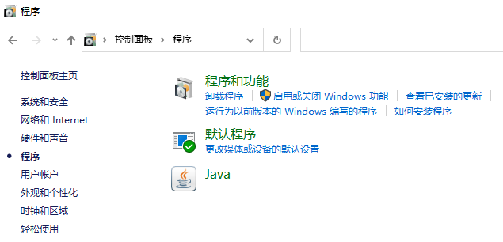
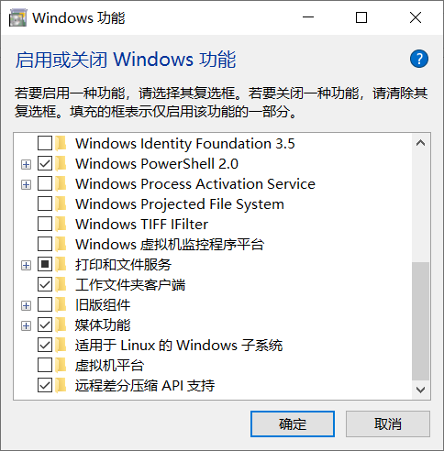
1.1 Install WSL on Windows 10
1 Download and install GCC on Windows 10 (Based on WSL)
Step one: enable the Windows Subsystem for Linux
Open powershell as Administrator and run: dism.exe /online /enable-feature /featurename:Microsoft-Windows-Subsystem-Linux /all /norestart
https://docs.microsoft.com/en-us/windows/wsl/install-win10

Slide 4
input 命令提示符

Slide 5
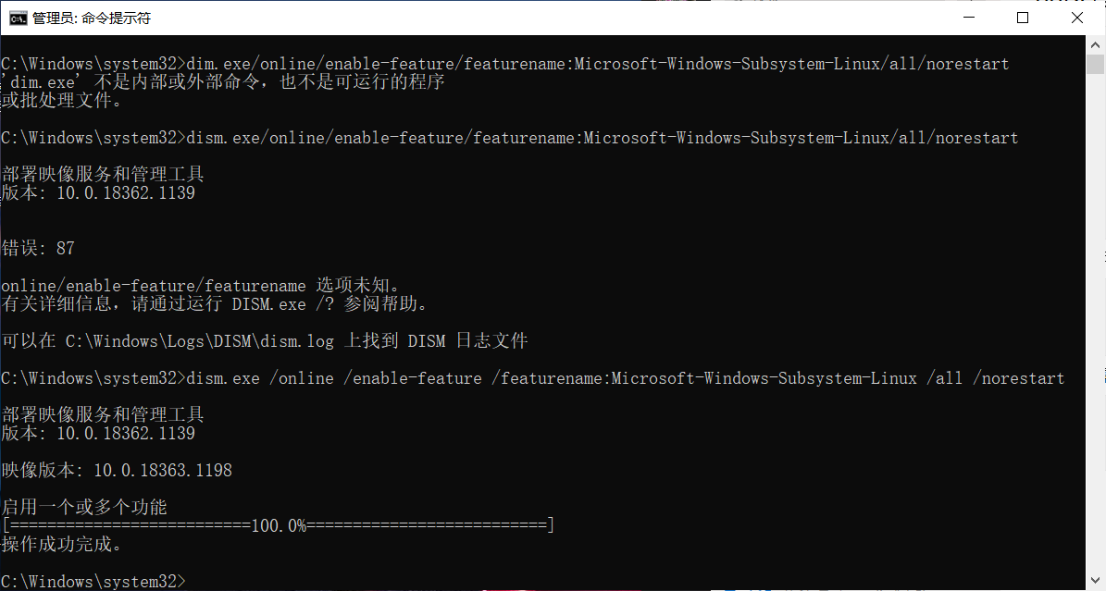
Notice the space in the commands

Slide 6
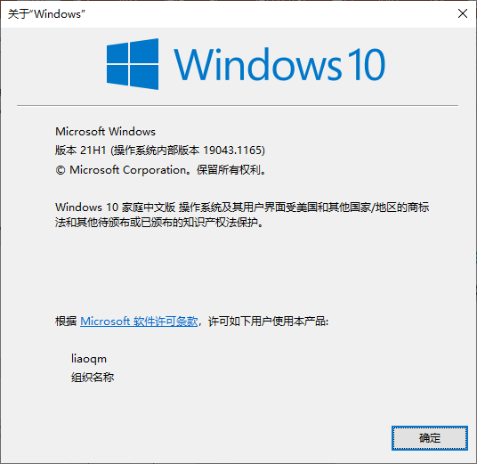
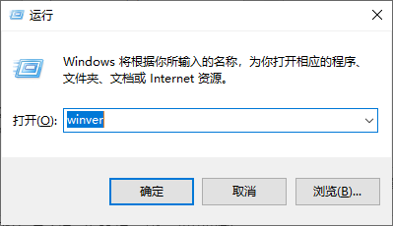
Step two: Check requirements for running WSL 2
To update to WSL 2, you must be running Windows 10.
For x64 systems: Version 1903 or higher, with Build 18362 or higher.
For ARM64 systems: Version 2004 or higher, with Build 19041 or higher.
To check your version and build number, select Windows logo key + R, type winver, select OK.

Slide 7
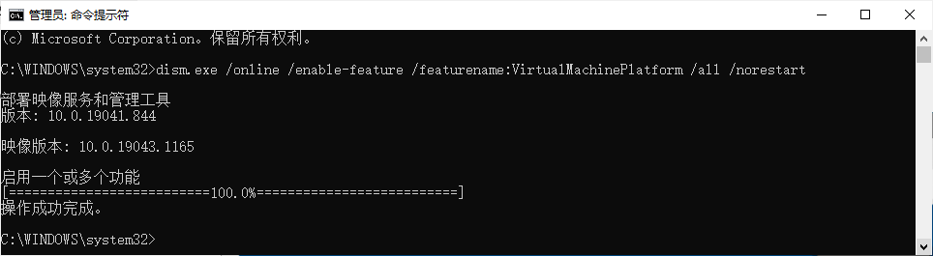
Step three: Enable Virtual Machine feature
Open PowerShell as Administrator and run: dism.exe /online /enable-feature /featurename:VirtualMachinePlatform /all /norestart
Restart your machine to complete the WSL install and update to WSL 2.

Slide 8
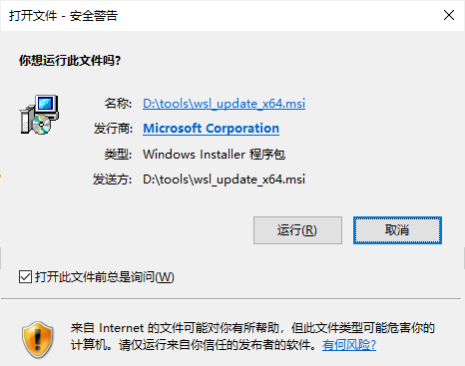
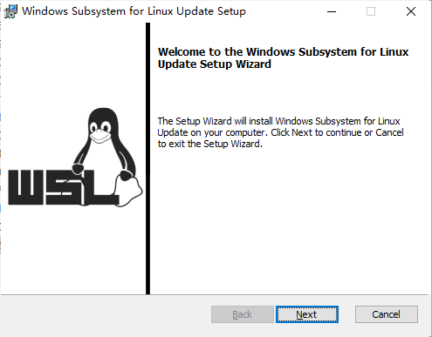
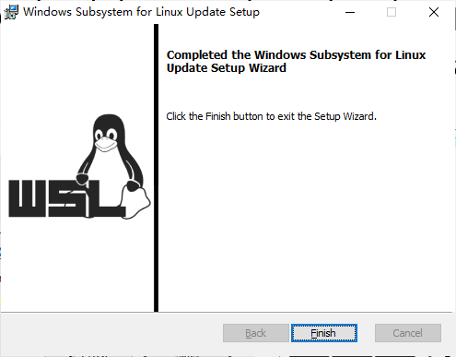
Step four: Download the Linux kernel update package
Download the latest package and run the update package
https://wslstorestorage.blob.core.windows.net/wslblob/wsl_update_x64.msi
If you're using an ARM64 machine, please download the ARM64 package instead.
https://wslstorestorage.blob.core.windows.net/wslblob/wsl_update_arm64.msi

Slide 9
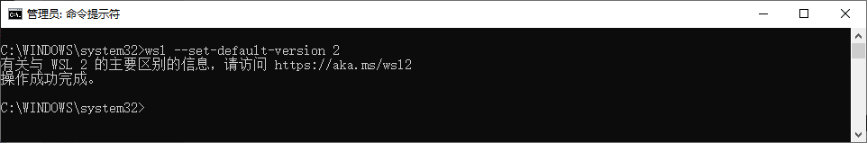
Step five: Set WSL 2 as your default version
Open PowerShell and run this command to set WSL 2 as the default version : wsl --set-default-version 2

Slide 10
Step six: install your Linux distribution of choice:
Open the Microsoft Store and select your preferred Linux distribution
Search Linux in Microsoft Store
input store

Slide 11
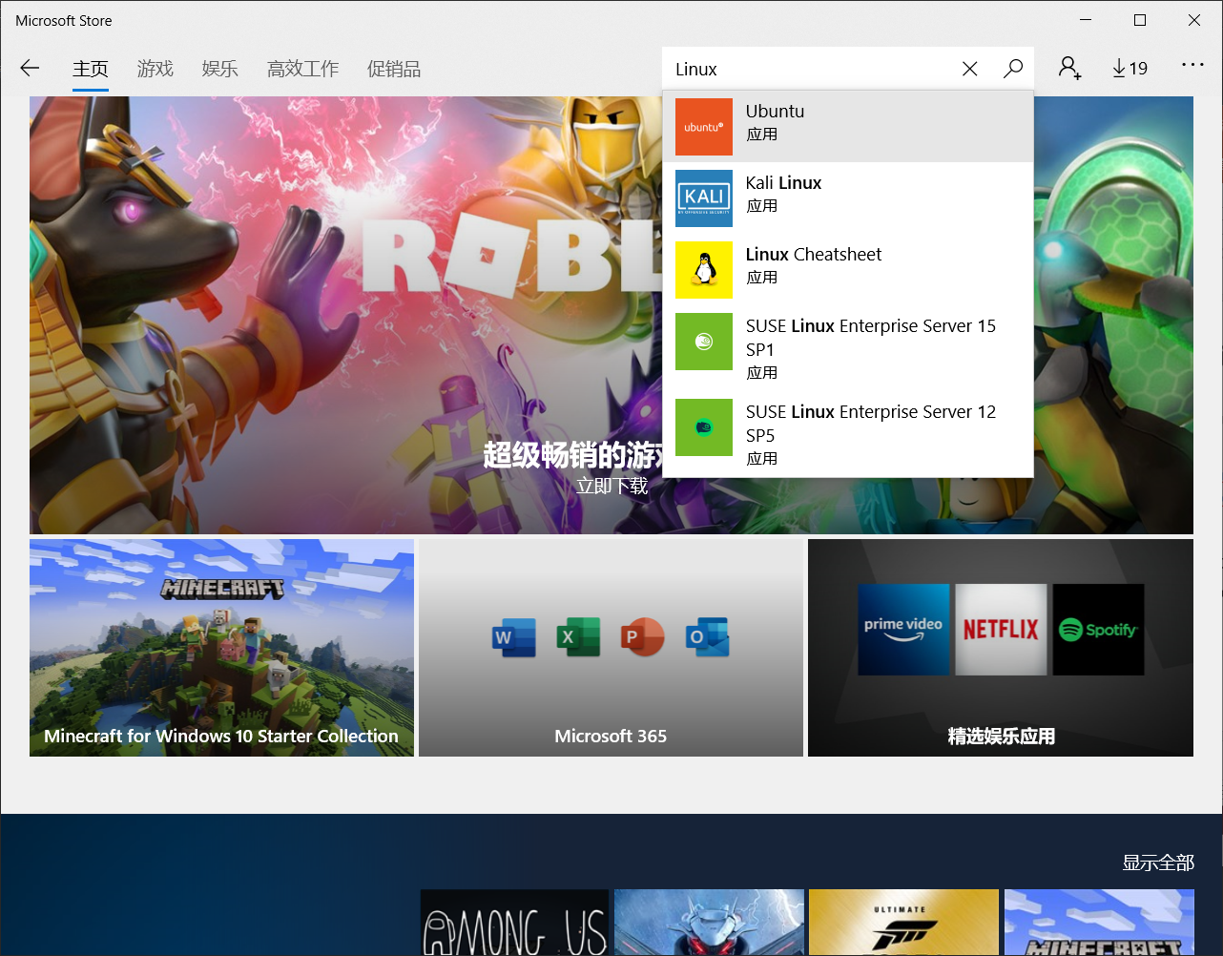
search Linux
select Ubuntu 应用

Slide 12
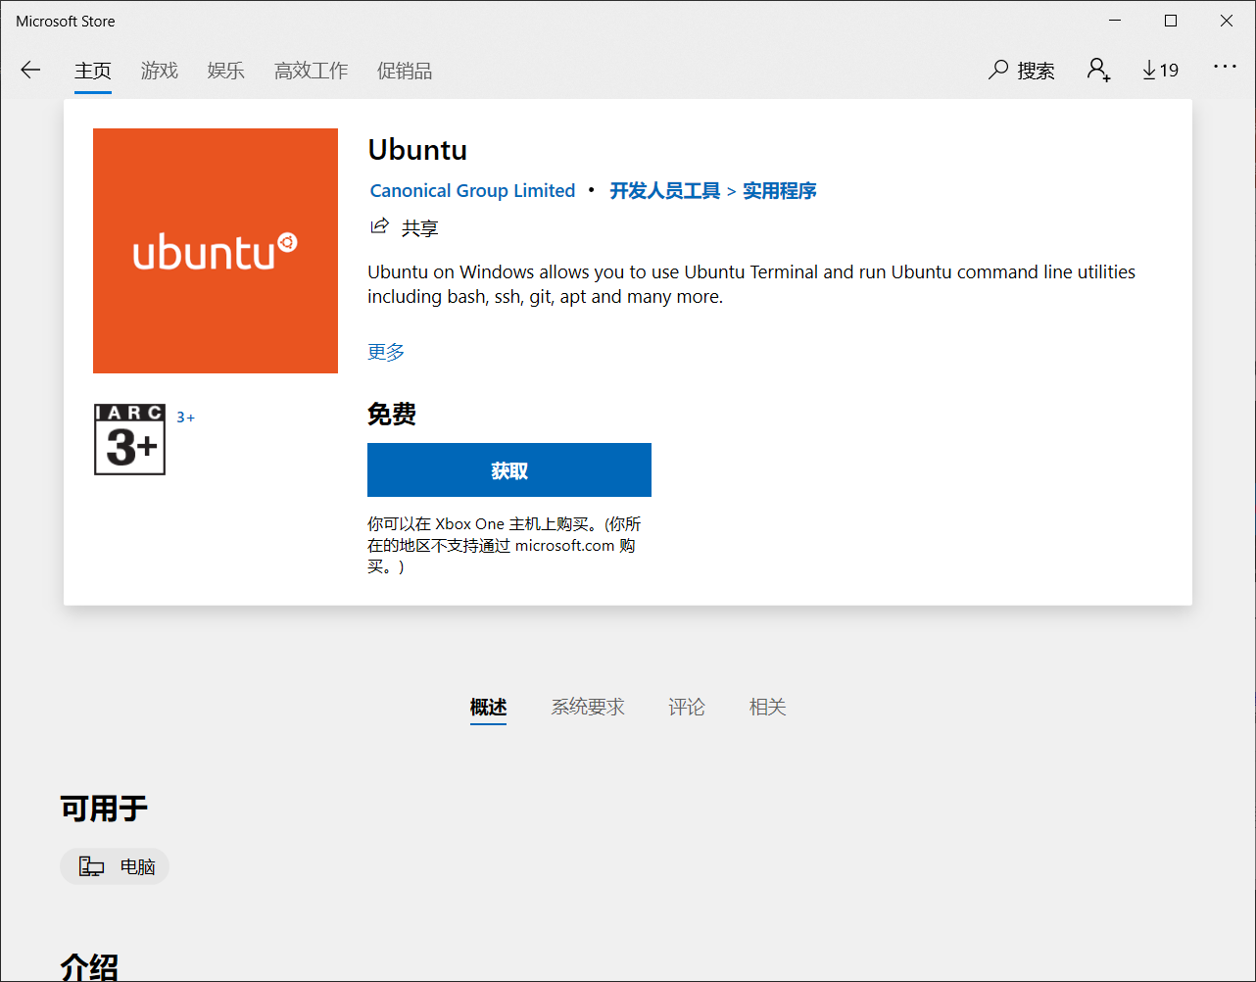

Slide 14
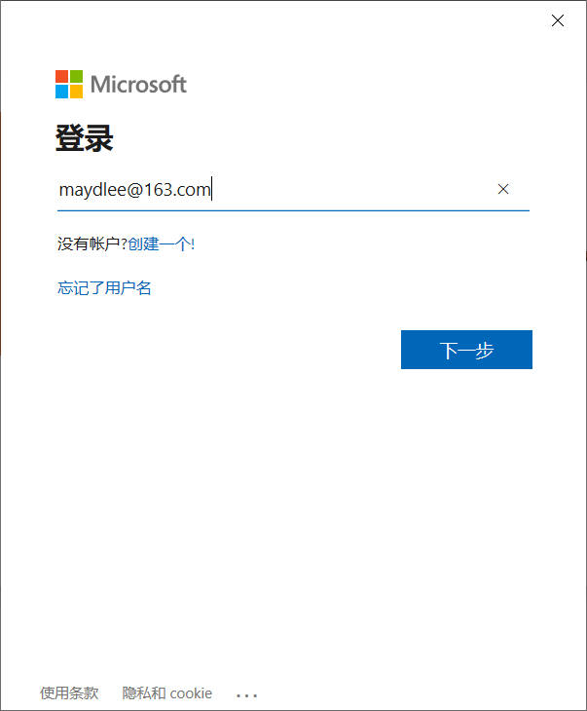
input your Microsoft account
If you have no account, you can create one

Slide 15
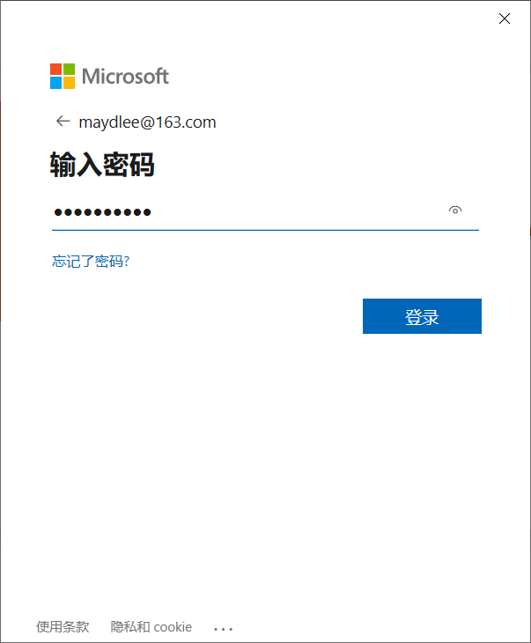
input your password

Slide 16
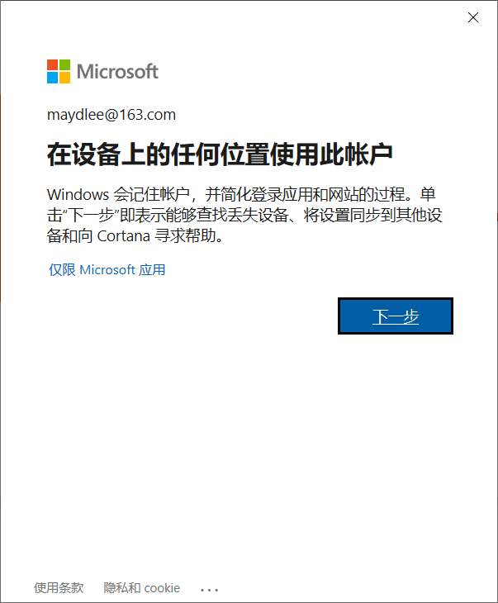

Slide 17
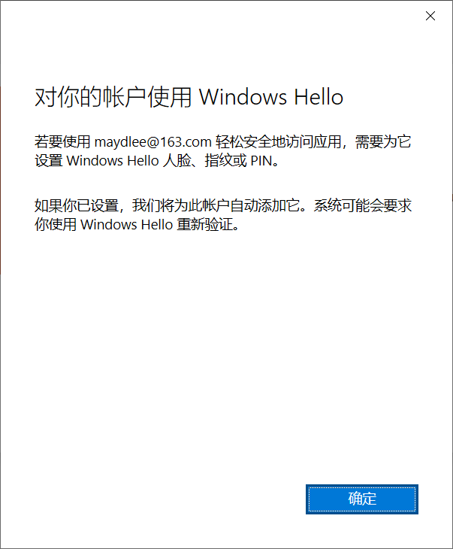

Slide 20
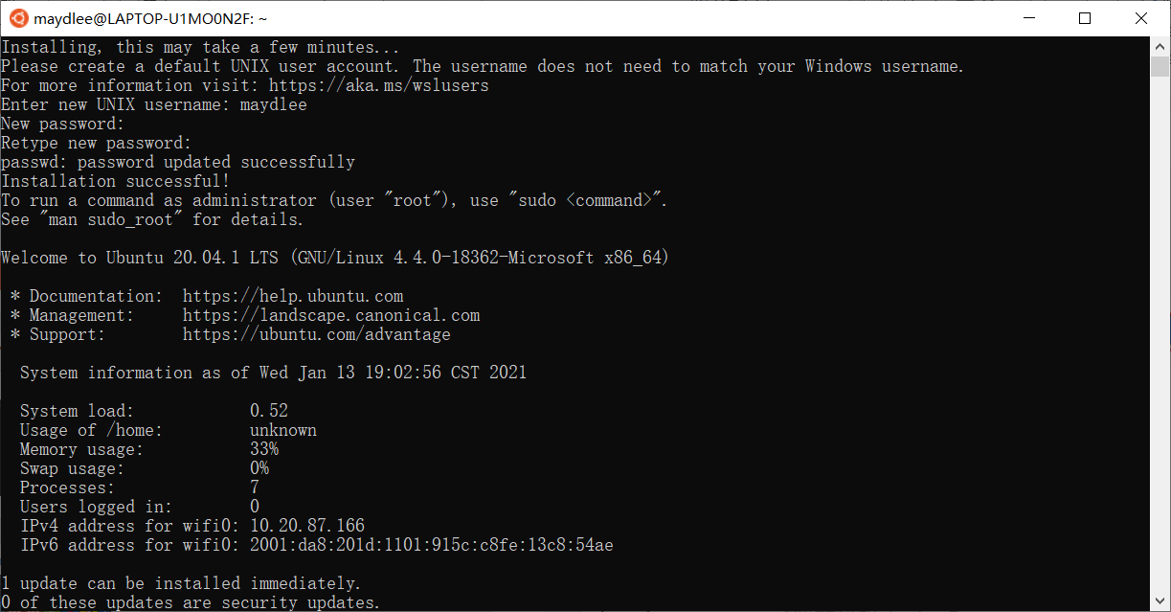
input new UNIX username and new password

Slide 21
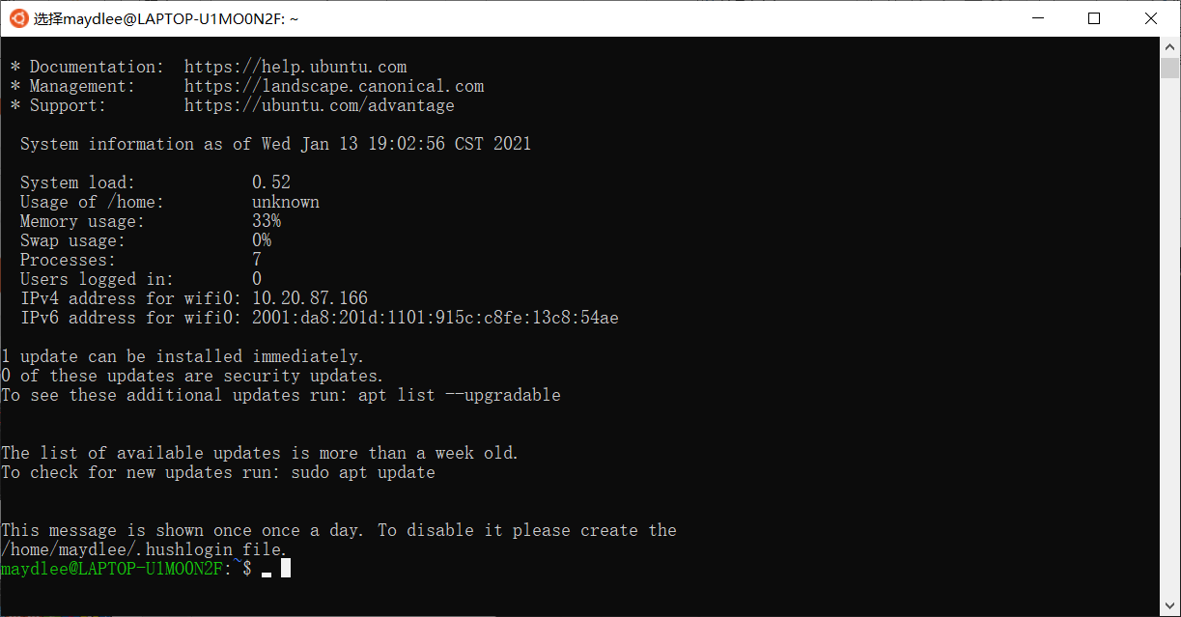
Linux command prompt

Slide 22
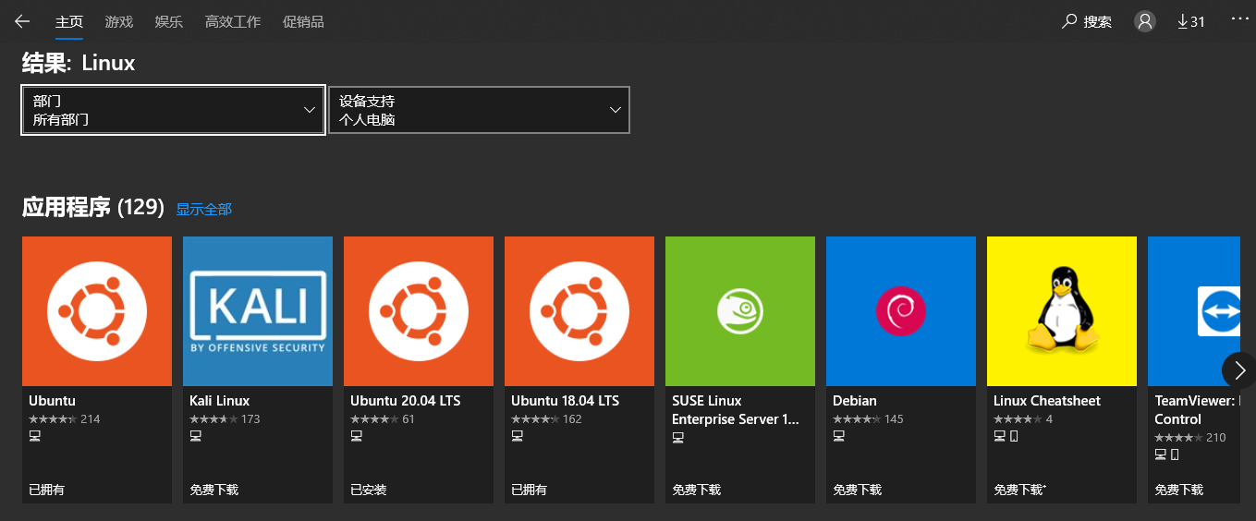
1.1 Install WSL on Windows 10 (Cont.)
We prefer Ubuntu 20.04 LTS and use this as an example in our class as this is the latest LTS version.

Slide 23
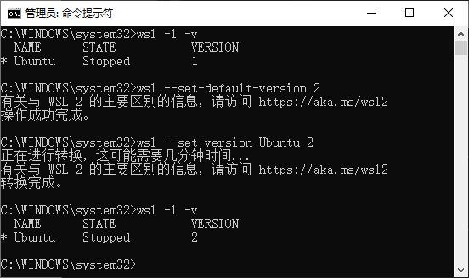
Check the version of WSL, make sure the version is 2. Input command: wsl -l -v
The version of WSL is 1
Input command: wsl –set-version Ubuntu 2
Input command: wsl -l –v again and check the version of WSL

Slide 24
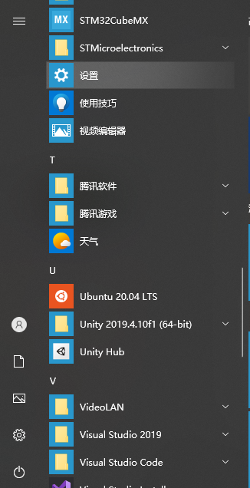
1.2 Install GCC on WSL
Once you finished the installation of Ubuntu 20.04 LTS, you can find it on your start menu.
Open it and you will see a Terminal for Linux
You can set username and password for your system (Please remember this password as you need it to switch to root user later)

Slide 25
1.2 Install GCC on WSL (Cont.)
You can change the source list of apt if you want. (This step may improve your download speed later)
For more information you can visit: https://mirrors.sustech.edu.cn/help/ubuntu.html#introduction
Use the command below to install GNU: (If you are using any Linux distribution based on debian you can use below to install, too)
sudo apt update;sudo apt install g++ -y
The first command will update your apt library (apt:Advanced Packaging Tools)
The second will install g++ and its independence

Slide 26
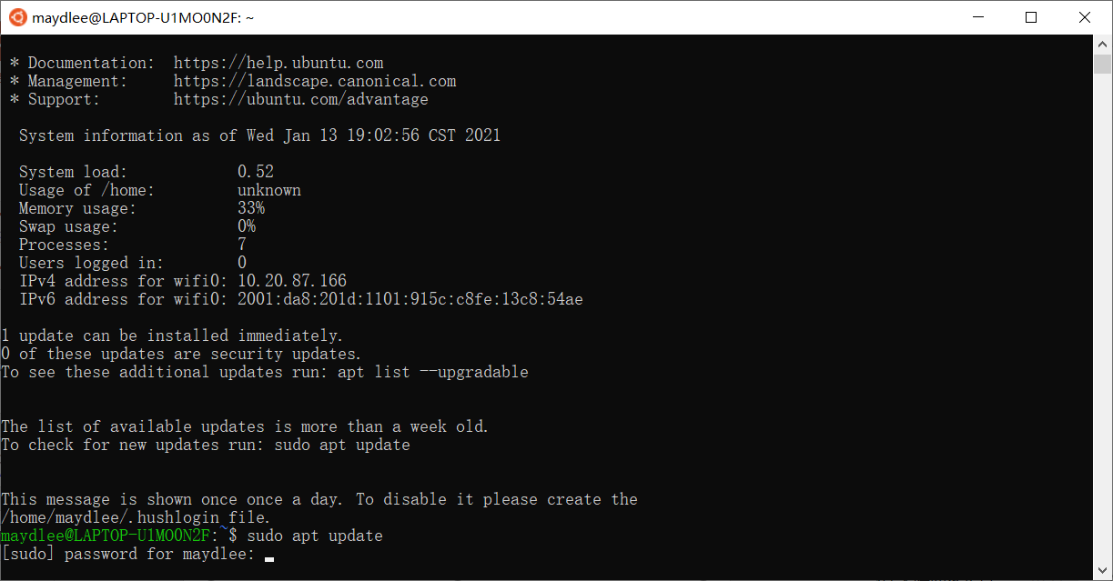
input the command and your password

Slide 27
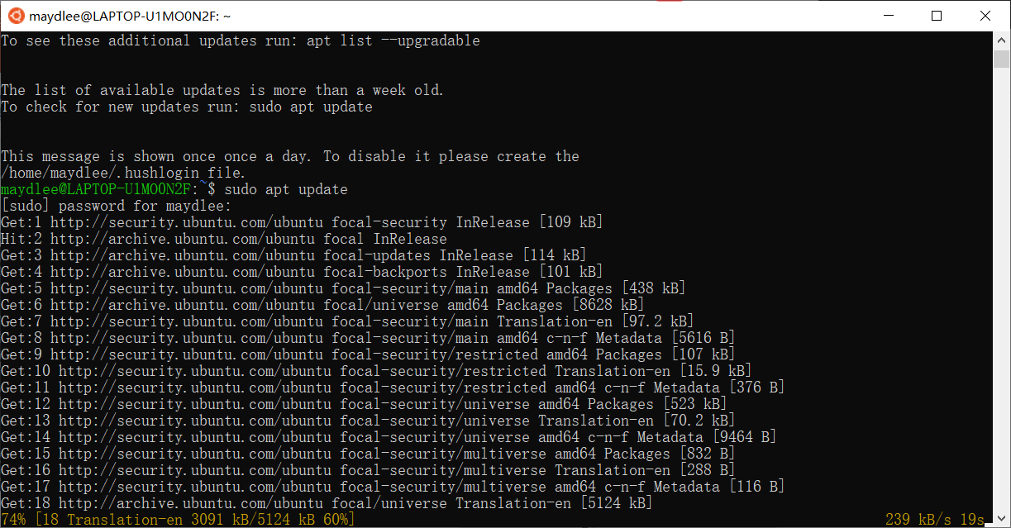

Slide 28
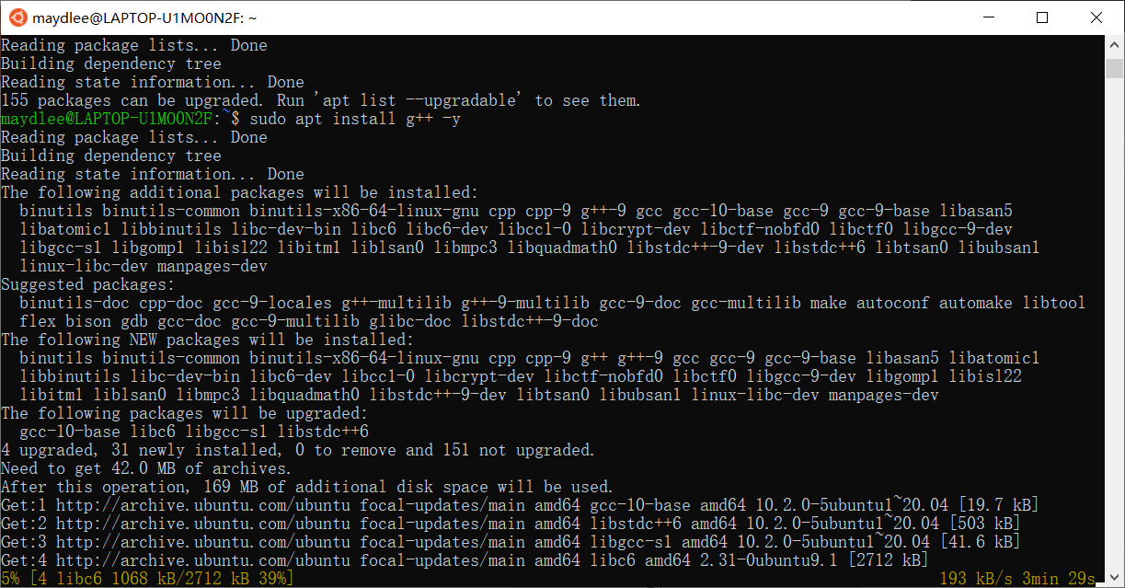
input the command to install g++

Slide 29
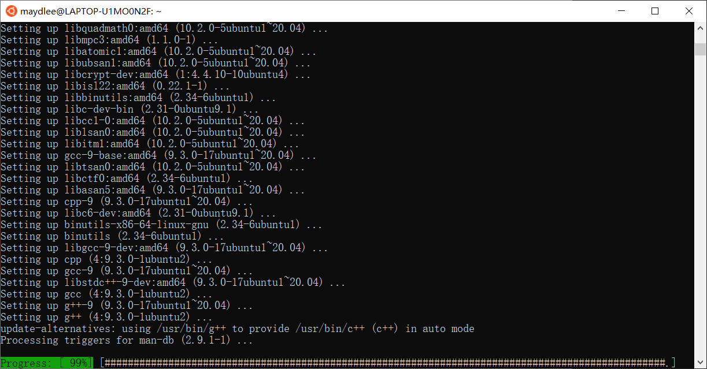

Slide 30
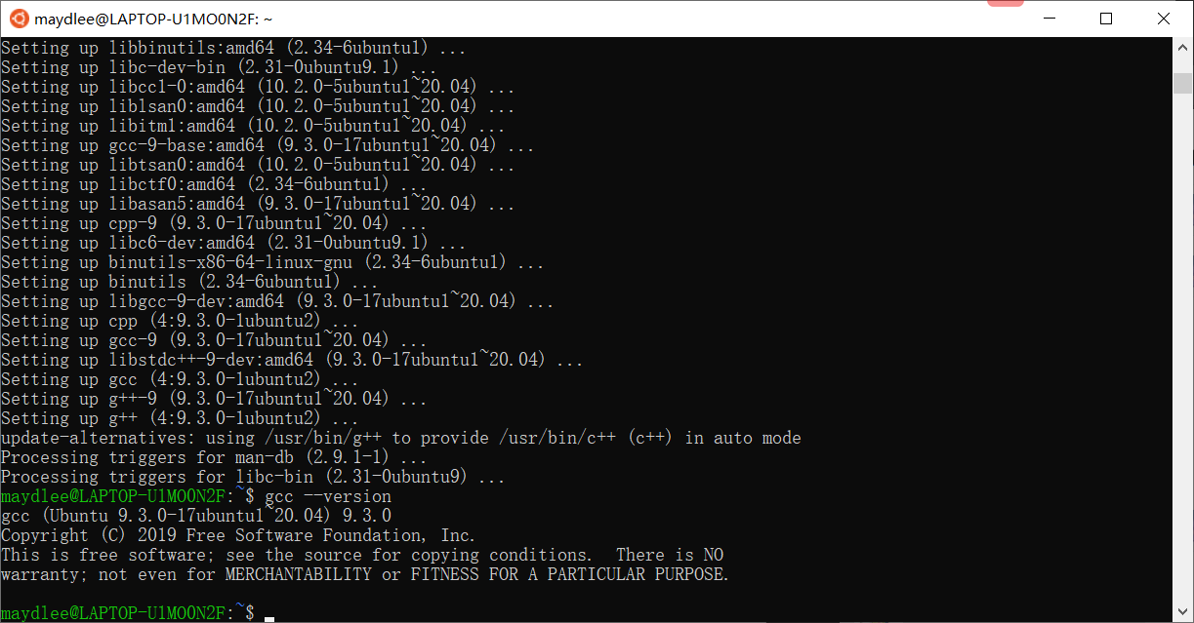
1.3 Verify GCC on WSL
You can input command: gcc --version or g++ --version to check whether the GCC is installed well
Input gcc –version or g++ --version to check if the compiler is installed successfully

Slide 31
2.1 Install CLT on macOS
2 Download and install LLVM on macOS
Open the Terminal on your Mac
Input g++ to check whether the CLT or GCC is installed
If not, the system will guide you to install CLT
You can also install CLT by package provided by Apple: https://developer.apple.com/download/more/

Slide 32
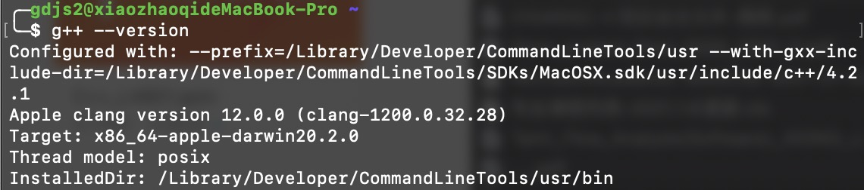
2.2 Verify LLVM on macOS
The same as verifying GNU, using: g++ --version

Slide 33
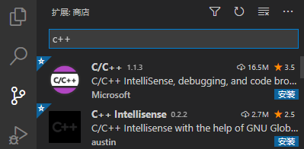
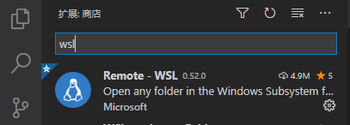
3.Download and install editor
To install VSCode, you can visit: https://code.visualstudio.com/ to download the package for your platform (Linux, Windows or macOS).
After you install VSCode, you need to install two plugins at least to support our development:
1. C/C++ plugin
2. Remote - WSL plugin
To install them, you can search c++ and wsl respectively.

Slide 34
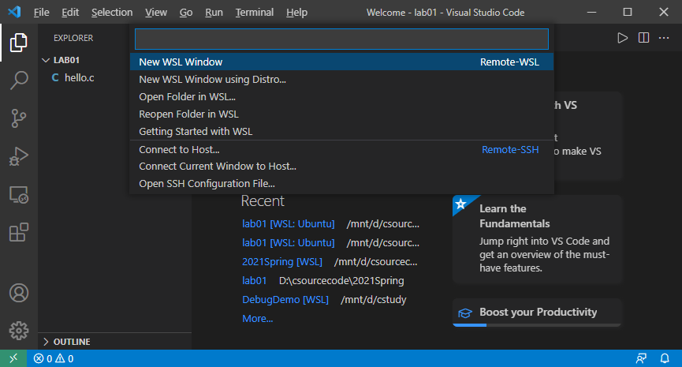
Now, you need to switch your VSCode to WSL system.
Click the green button on left of the bottom, and choose Remote WSL: New window (or others you need).

Slide 35
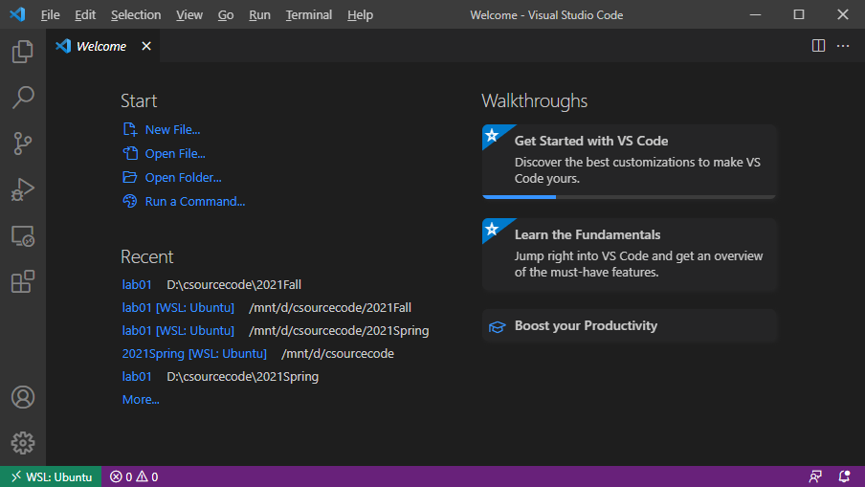
Now your VSCode is working on the WSL system. We can create our first C/C++ program.
Note: The suffix of the program must be .c or .cpp for c program and c++ program respectively.

Slide 36
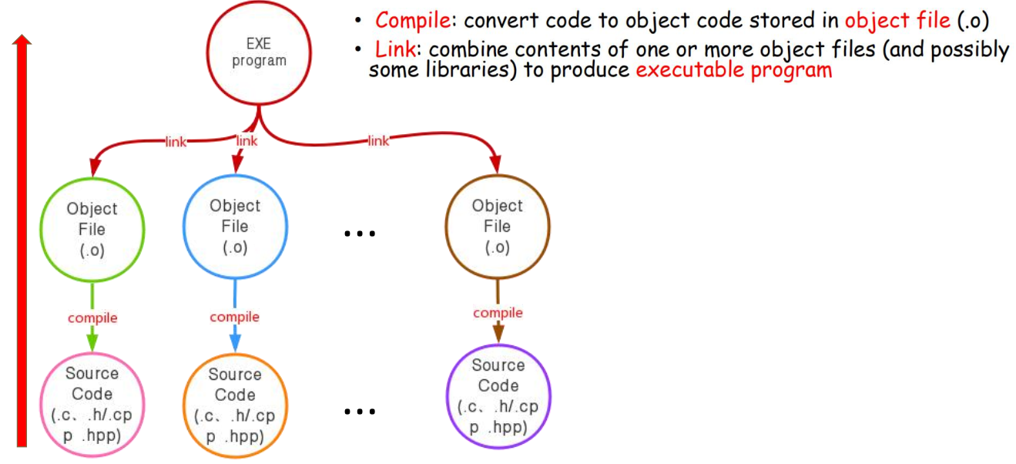
4 Compile, Link and Run C/C++ Programs
4.1 The program compilation process

Slide 37
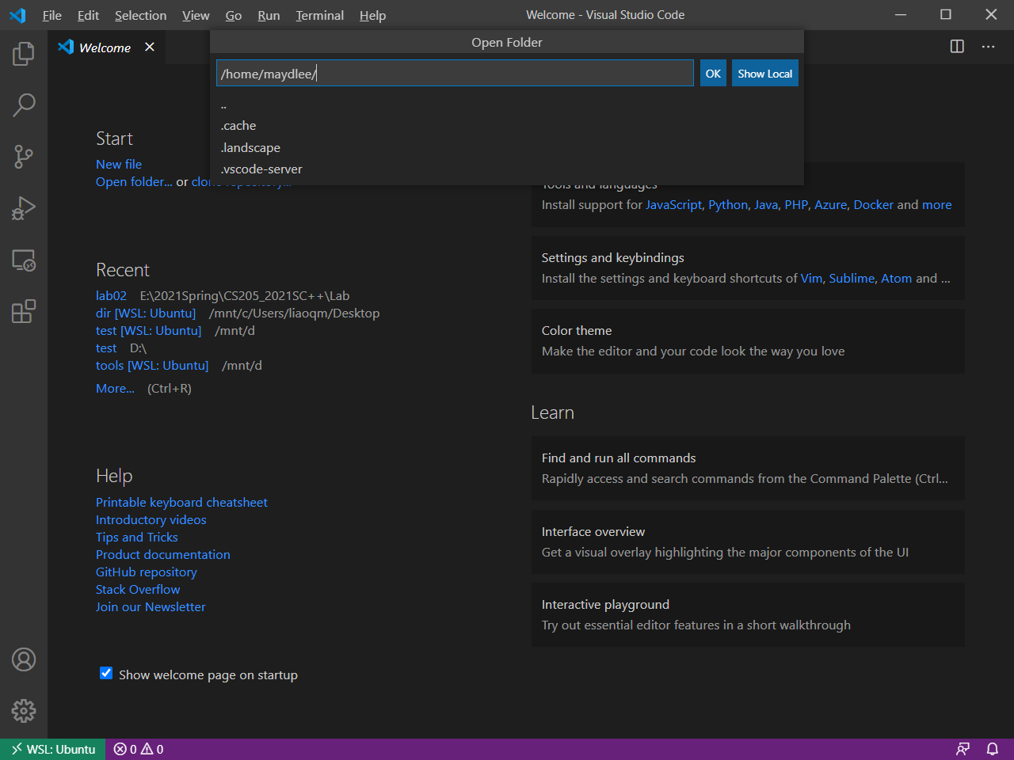
4.2 Compile, Link and Run C programs
Compile/Link/Run a simple C program – hello.c
Write your codes in VScode
Click “Show Local” button
Click “Open folder” button

Slide 38
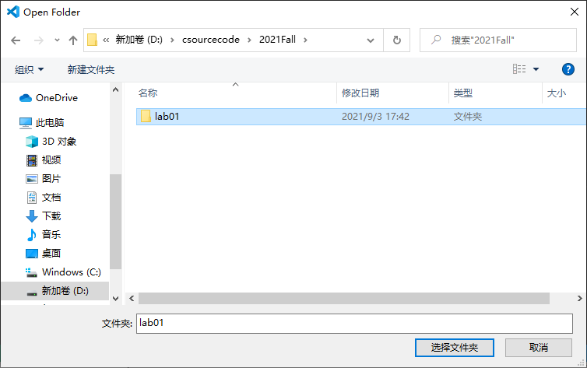
Find your folder where the code will be stored and select the folder.

Slide 39
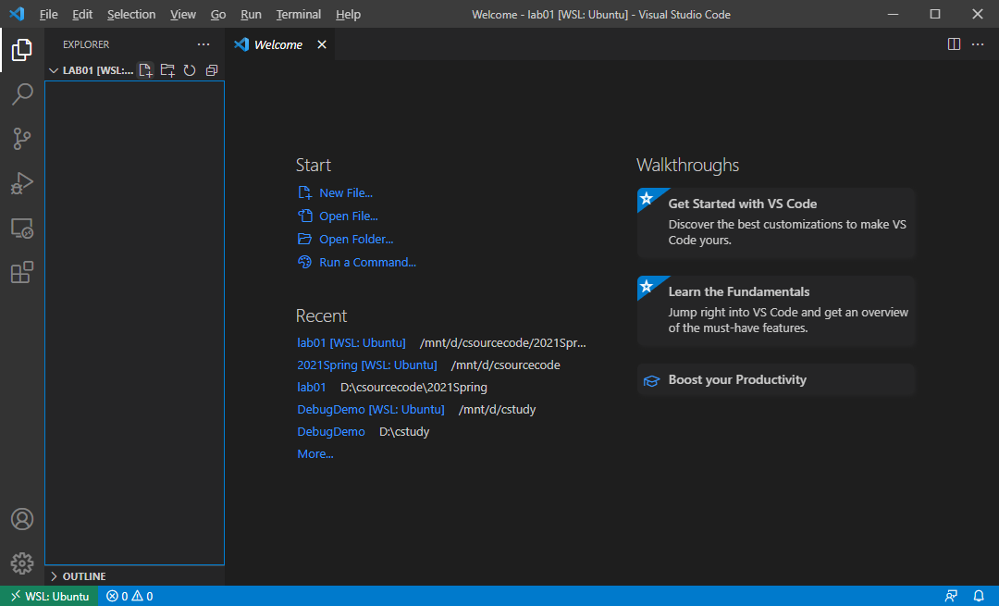
Click “New File” button or select “File”→”New File” menu to create a new file

Slide 40

Input your file name and press Enter

Slide 41
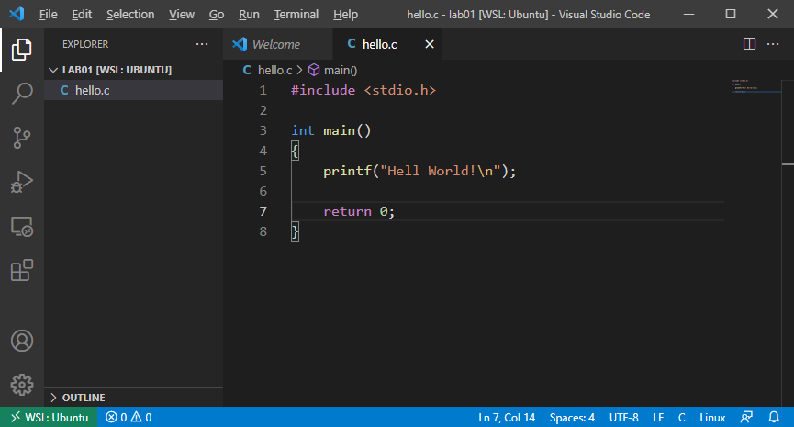
Input the code below and save the file.
Input your code in the editor window

Slide 42
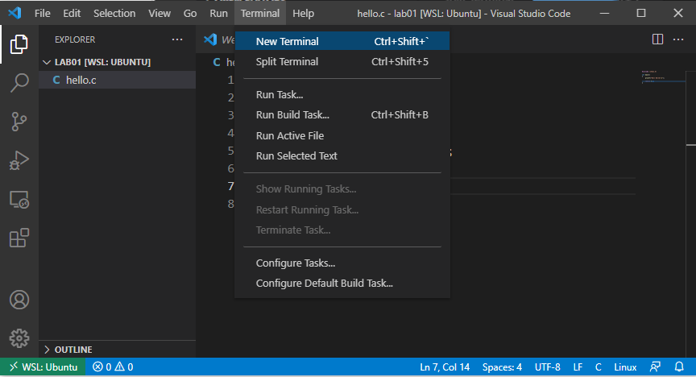
Select “Terminal”→”New Terminal” menu to open the Terminal window

Slide 43
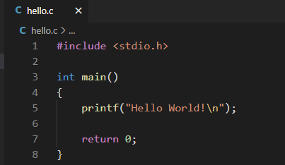
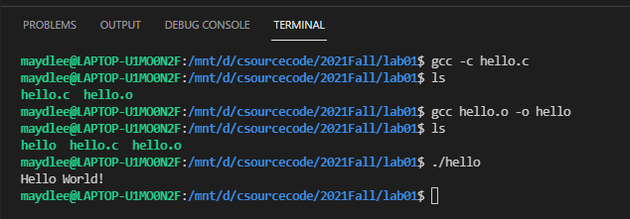
Use gcc to compile the .c file.
compile
link
run
The output

Slide 44
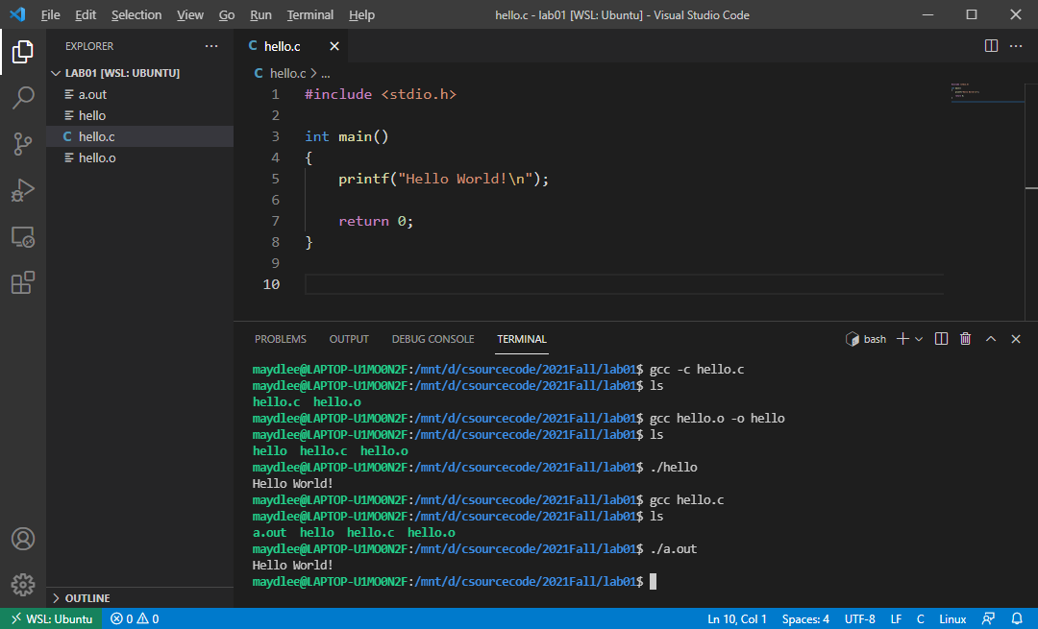
The default output executable file is called “a.out”(Unix and Mac OS) if you don’t specify the name in compiling and linking step.
compile and link
run a.out
The output

Slide 45
4.3 Compile, Link and Run C++ programs
Compile/Link/Run a simple C++ program – helloworld.cpp
Select “File”→”New File” menu to create a new file

Slide 46
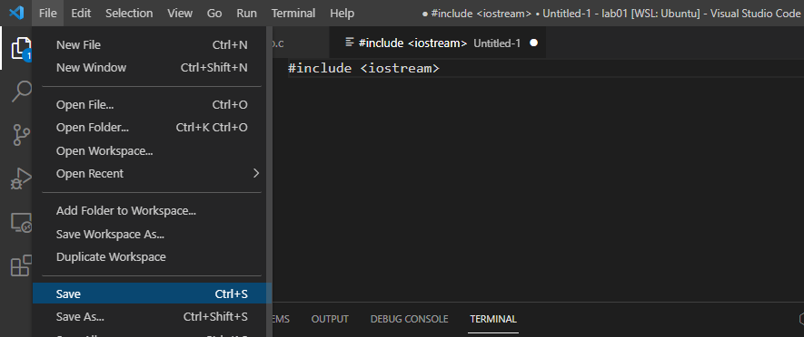
Input your code in the new file
Select “File”→”Save” menu to save the new file

Slide 47
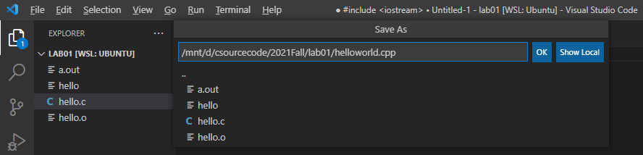
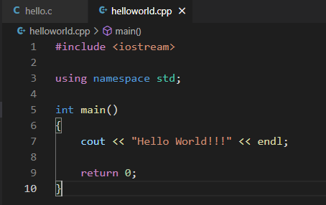
Input your file name and press “OK” button

Slide 48
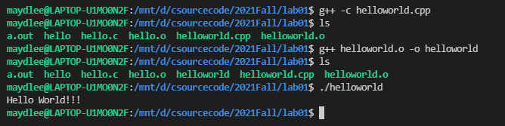
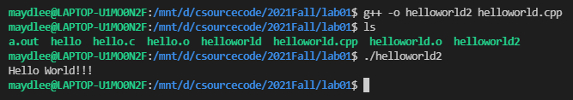
You need to use g++ to compile C++ program, as follows. We use the -o option to specify the output file name.
compile
link
run
The output
compile
and link
run
The output

Slide 49
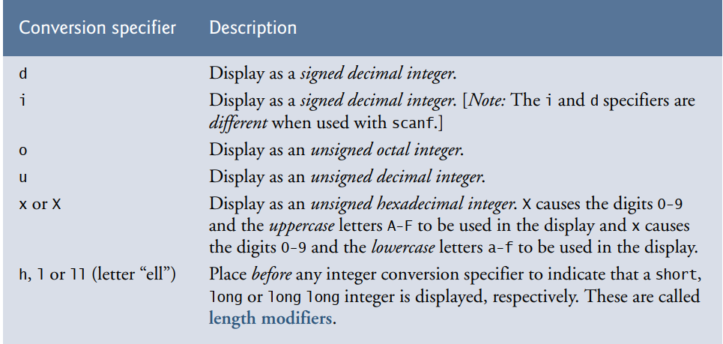
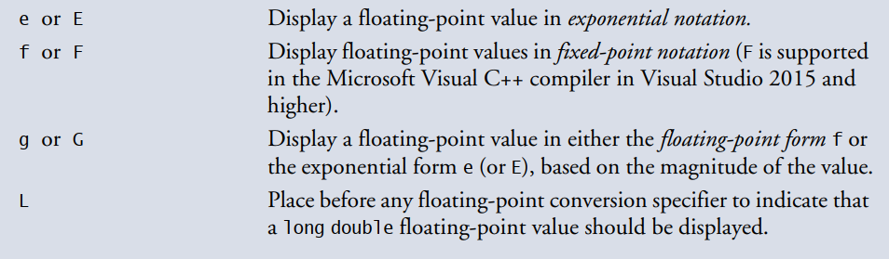
5 Terminal Output
5.1 Formatting output with printf
printf (format-control-string, other-arguments)
format-control-string describes the output format, which consists of conversion specifiers, field widths, precisions and literal characters with percent sign(%).

Slide 50
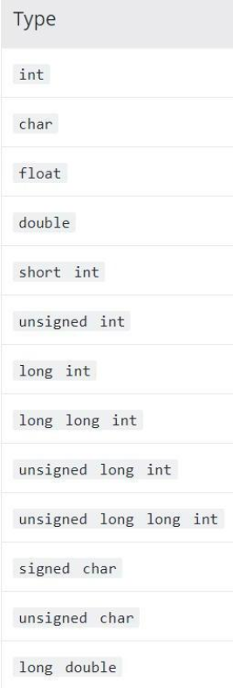
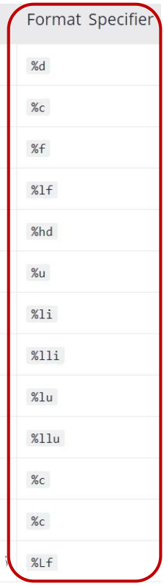
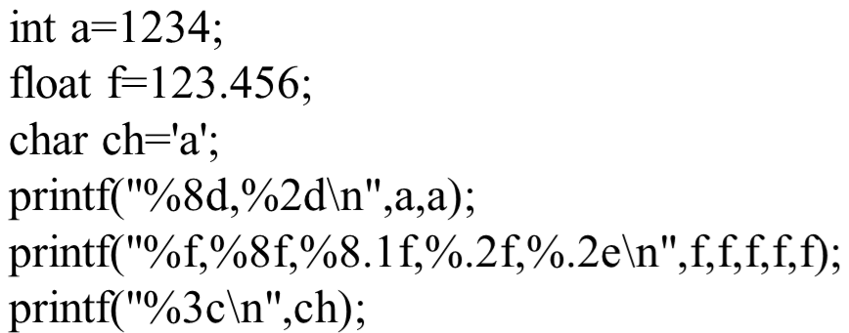

Example:
Sample output:

Slide 51

5.2 cout
cout << variable1(expression1) [<< variable2 << variable n];

Slide 52

6.1 Exercises
Write a program to initialize three variables which equal to 0.1, 0.2, 0.3, then print them with two decimal points.
Your output should look like something above. You can use printf to achieve this, or you can explore the cout way.

Slide 53
6.2 Exercises
Copy the following code into 3 files, and compile them together to an executable file. Find the bugs if there are some.
main.cpp
add.h
#include <iostream>
#include "Add.h"
int main()
{
int num1 = 2147483647;
int num2 = 1;
int result = 0;
result = add(num1, num2)；
cout << “The result is ” << result << endl;
return 0;
}
#pragma once
int add(int n1, int n2);
add.cpp
#include "add.h"
int Add(int number1, int number2);
{
return n1 + n2;
}

